Slide 1

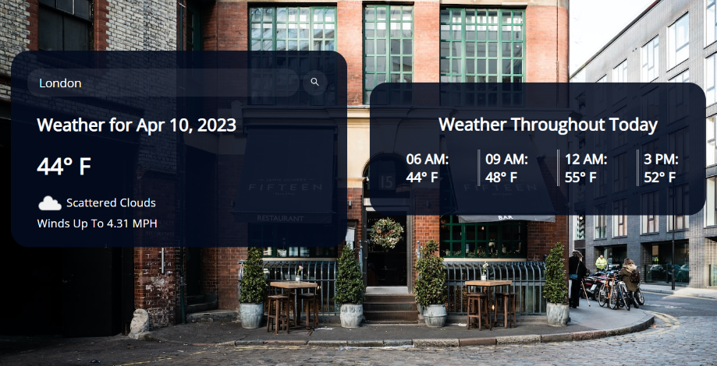
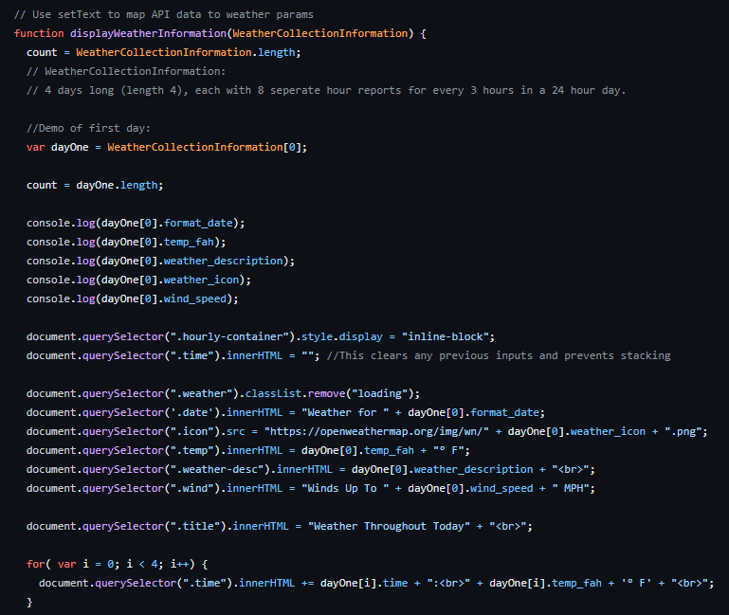
Cortland Diehm, Steven Werden, Nikki Theresa Diguard, Ash Dewald, Renee Edison
Introduction/Scope of the Project
As part of the final project, the Weather Warriors developed a website where the user will be able to see weather for any given city. The current weather will display and then a daily forecast will appear. This page will give people a way to explore the weather around the world. The website is intended to be used for anyone interested in the weather. The interface will be simple enough for anyone to use.
Design
Conclusions
In conclusion and after several group meetings and collaboration, a working prototype has been developed and tested. The Weather Warriors worked well together and found ways of creating a weather website that is unique. A short demonstration will be included in the video that will accompany this project. The video describes our collaboration and website functions.
Recommendations or Future Work
In addition to the current weather, a future enhancement would return a picture of the city selected. This will provide for a better experience for the user.
Provide an opportunity for a user to “email” or “text” results to a given email address or phone number
Give the user the ability to set a default city.
Create a mobile application that people can download.
A real-time map that displays other weather conditions like incoming storms for a certain city.
Include weather patterns off-world, the moon…
Technology
The tools that we utilized for this project are GitHub Repository, Google Docs, Microsoft Teams, Discord, and Adobe Express.
The system technology includes a website. JavaScript was used to contain and interpret the API. HTML will be used to frame the webpage and a bootstrap CSS embedded in HTML to alter the style of the webpage. There are functions and to better layout the website with JavaScript. OpenWeatherAPI will be used to grab the data needed to return the results.
Requirements
Need the ability to link to the webpage
A user must be able to enter a city name
The page must return the results of the current weather for the city requested
System must allow for multiple searches; one after another.
Results must include current temperature and current weather conditions.
References
OpenWeatherAPI -https://openweathermap.org/api

